Slide 1

Survey of Mental Health In Tech Companies
Course: Introduction to machine learning and data mining
Professor: Martin Schedlbauer
Submitted by: Harsh Janyani

Slide 2
Objective
Survey on Mental Health in the Tech Companies Dataset from the Kaggle website.
Considering Mental Health in Tech companies is regarded as one of the pressing issues nowadays.
According to a recent survey, 51% of tech professionals have diagnosed with a mental health condition.
My goal is to study this Survey dataset and make predictions whether the professional sought treatment or not.

Slide 3
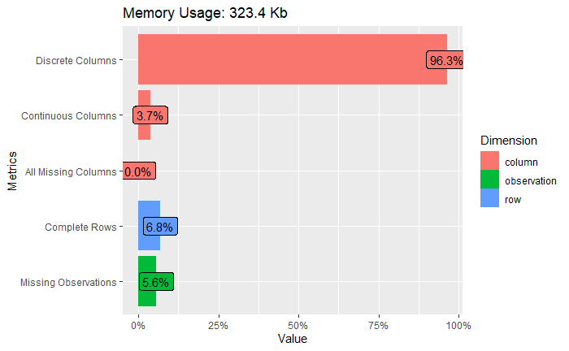
Data Understanding
Plot_intro() function was used to understand the type of dataset.
In the following figure, we can see that most of our data is discrete/categorical data.
Age feature is the only continuous column present in the data.
There a couple of missing observations present.

Slide 4
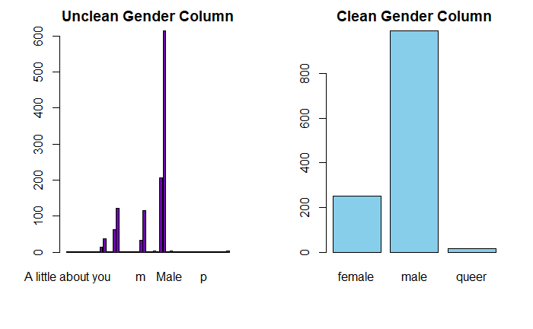
Data Preparation
Most important phase of data preparation is cleaning of data.
It is observed that Gender column is unclean input values.
To clean the column separate categories have been made.
Apart from that, we saw the data has a couple of missing values. These missing values are imputed using either by median and mode methods.
Along with that outliers have also been removed.

Slide 5
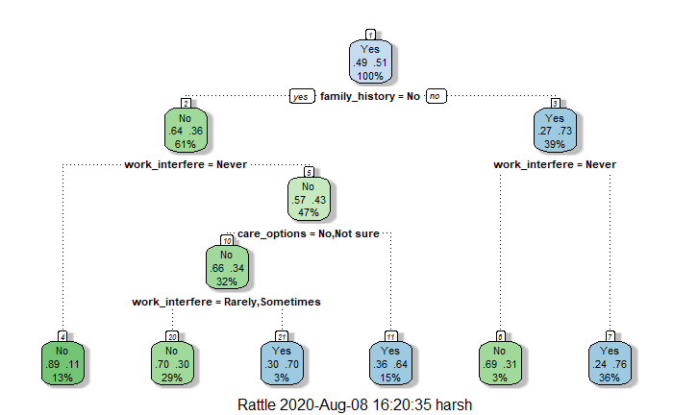
MODELLING
For making predictions, 4 types of models were tested which are as follows:
1. Support Vector Machine
2. Neural Network
3. Logistic Regression
4. Decision Trees
Along with this, an ensemble model of all the models using is built using stack learner functions from caretEnsemble package.

Slide 6
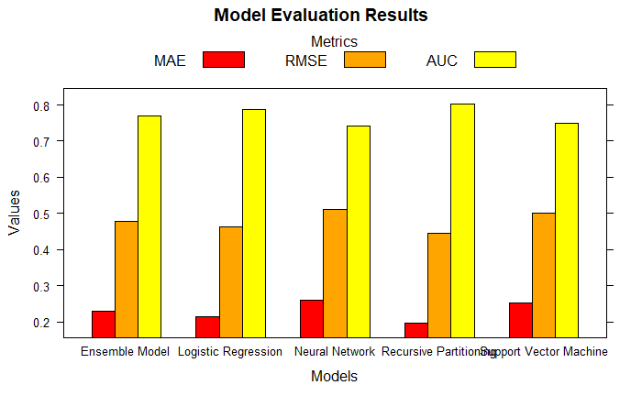
Evaluation
Model evaluation is done using 3 methods which are as follows:
1. Root Mean Squared Error (RMSE)
2. Mean Absolute Error (MAE)
3. Area Under the Curve (AUC)
Since the size of the data is small, K-fold cross-validation is used to test the data collection.

Slide 7
Thank you

